Slide 1

Adobe Analytics Challenge 2024
By Team: Under the Guidance Of:
Terrapin Trio Zachary Drake
adobeanalyticschallenge.com

Slide 2





Terrapin Trio
University of Maryland, College Park
Sneha Murali
Stuti Shrimal
Ashish Salunkhe

Slide 3
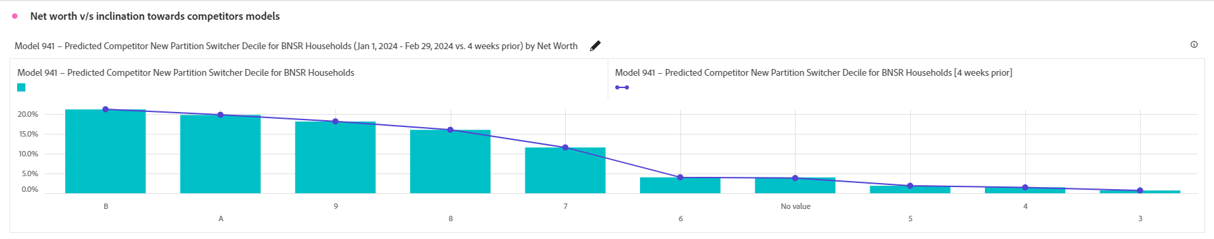
Net Worth Of Consumers V/S Inclination Towards Competitors Models
Findings
Among individuals with a net worth greater than $1,999,999 (class B), 21.2% are inclined towards purchasing competitor models whereas for those with a net worth in between (class 3), the inclination towards buying small to mid-sized SUVs stands at 0.7%.
This suggests that individuals with a net worth exceeding $500,000 are significantly more likely to transition to a competitor's model compared to those with a net worth below $500,000.
Suggestions
Enhanced Customer Experience: Offer personalized services, loyalty programs, and exceptional customer support to strengthen their connection with your brand. Provide exclusive perks such as VIP access, early product releases, and premium service packages for customers with higher net worth.
Product Innovation: Continuously introduce new features, upgrades, and models that cater to the evolving needs and preferences of high-net-worth individuals.

Slide 4
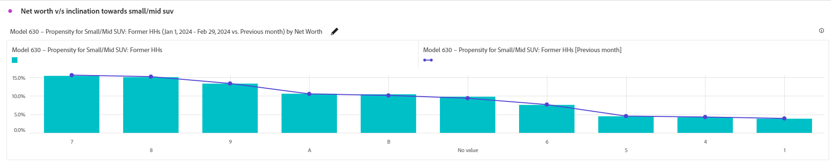
Net Worth V/S Propensity Towards Small/Mid SUV
Findings
Among individuals with a net worth ranging from $100,000 to $250,000 (class 7), 15.4% express a preference for purchasing small to mid-sized SUVs, whereas for those with a net worth less than $1 (class 1), the inclination towards buying small to mid-sized SUVs stands at 3.8%.
Which means that as the income decreases the inclination shifts towards buying small /Mid SUV increases.
Suggestions
Affordable Alternative: Introduce more affordable vehicle options that are attractive to individuals with lower net worth, such as compact cars or used vehicles.
Financial Incentives: Offer special financing rates, discounts, or rebates specifically targeting individuals with lower net worth to make alternative vehicle options more financially appealing.

Slide 5
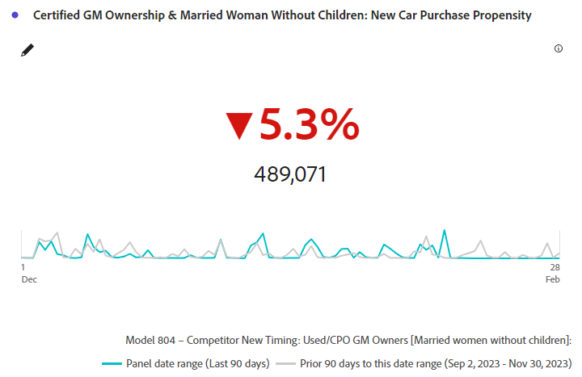
Key Performance Metrics For User Patterns In Purchasing New GM Models
Findings
For the past 90 days, Married women without children who have purchased a GM vehicle before, have been losing interest in purchasing new GM vehicles to be launched in the next 6 months and have been eyeing vehicles from competitors.
Suggestions
Implement targeted marketing campaigns emphasizing GM vehicles' family-friendly features, safety, and style, addressing the specific needs and preferences of married women without children.

Slide 6
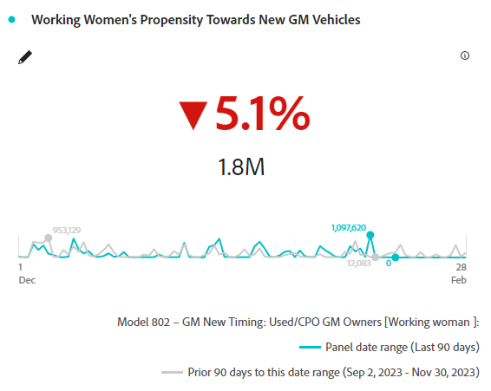
User Patterns In Purchasing New GM Models (Contd)
Findings
Suggestions
Over the past 90 days, working women who have purchased a GM earlier are losing interest in buying new GM models launching in 6 months by 5.1%
Introduce flexible financing options, highlight advanced tech features catering to their busy lifestyles, and create a seamless, customer-centric purchasing experience to rekindle interest among working women.

Slide 7
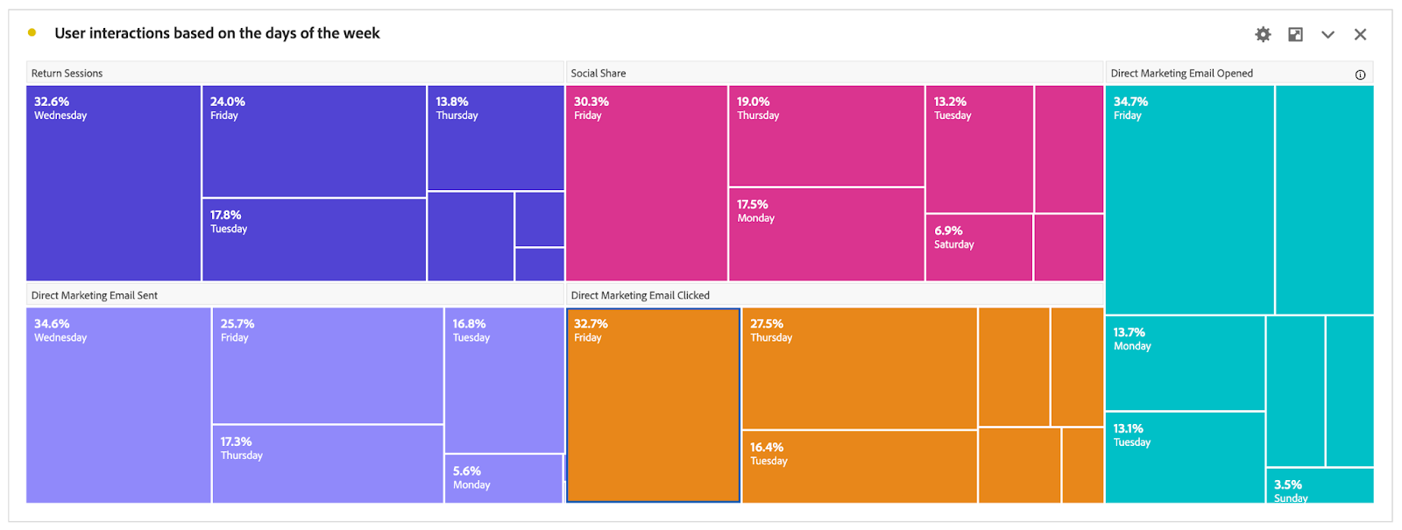
User Interactions Based On Days Of Week
Suggestions
Findings
Schedule your email campaigns strategically, sending them out on Fridays, Mondays, and Tuesdays to maximize open rates.
Offer special promotions or discounts specifically on these days to encourage repeat visits.
Implement email marketing campaigns with personalized content targeting previous visitors, highlighting offers or updates on Wednesdays, Fridays, and Tuesdays.
Craft compelling subject lines and preview text to entice recipients to open emails on these days.
Segment your email list and personalize content based on user preferences and behavior to increase engagement on peak days.
GM sends 33% of its emails on Wednesdays but they are mostly opened by potential consumers on Fridays!
Most return sessions on Wednesdays – 33%
Fridays usually attract more social engagement - 30%

Slide 8
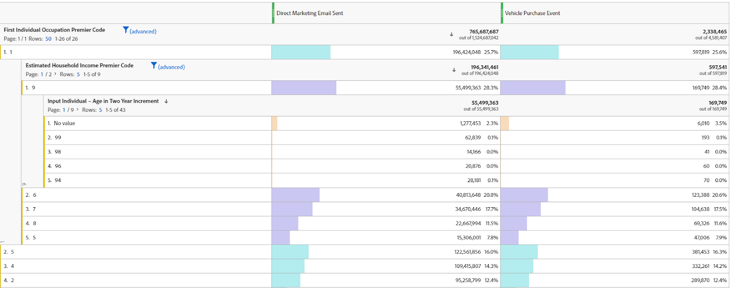
Email Patterns Based On Occupation V/S Income

Slide 9
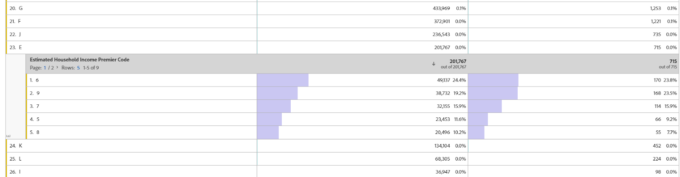
Email Patterns Based On Occupation V/S Income (Contd)
Findings
Professionals in technical occupations (code 1) are the top purchasers of vehicles and the primary recipients of marketing emails.
Self-employed managers (code E), despite similar incomes to top buyers, show minimal purchases and email engagement, indicating a need for targeted marketing.
Suggestions
Tailor marketing efforts to Class E's needs, highlighting GM vehicles' adaptability, reliability, and affordability.
Engage Class E directly through personalized communication channels, showcasing how GM vehicles meet their specific needs.
Provide exceptional after-sales support, including dedicated customer service, maintenance packages, and warranty extensions.
Implement referral programs to incentivize Class E customers to advocate for GM, fostering brand loyalty and expanding the customer base.

Slide 10
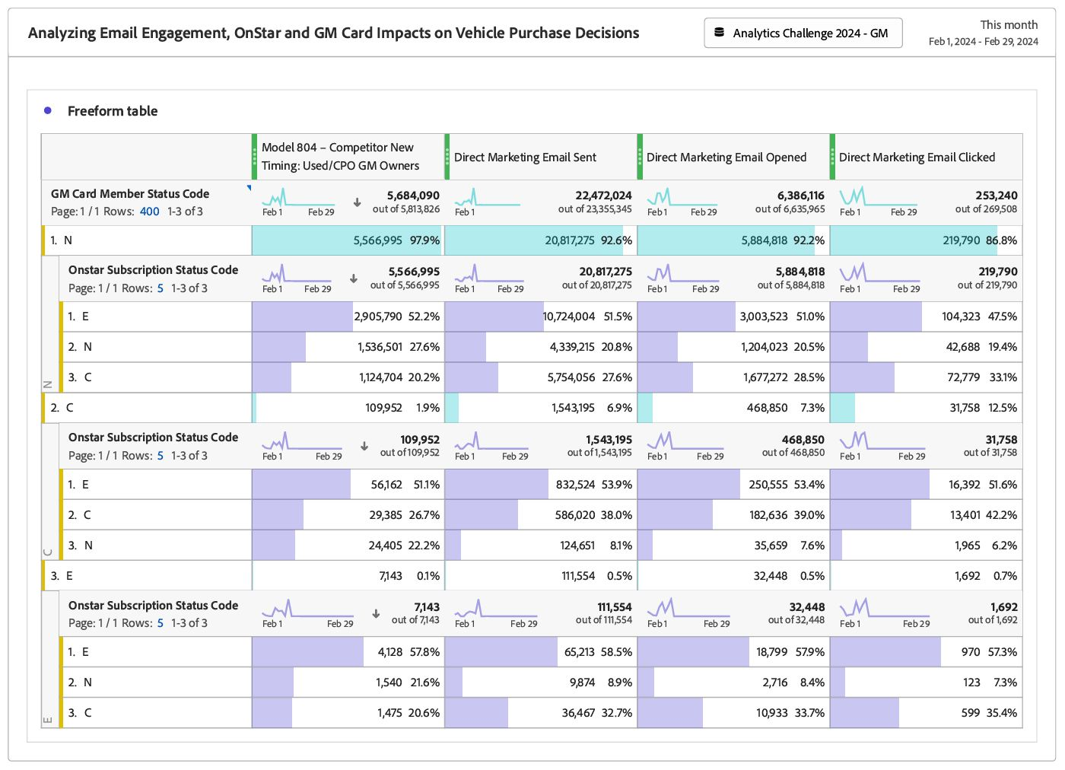
Analyzing Email Engagement, OnStar and GM Card Impact on Purchase Choices
Findings
Customers without active GM Card accounts demonstrate consistently high engagement, with open rates around 90% and click-through rates around 90%, indicating potential receptiveness to marketing efforts.
Current OnStar subscribers show higher engagement rates, with open rates above 50% and click-through rates around 7%, suggesting a correlation between active subscription status and receptivity to GM-related communications.
Suggestions
Leveraging OnStar benefits in campaigns could further enhance engagement among current subscribers, while past subscribers exhibit moderate interest, suggesting potential for re-engagement strategies.
Conduct A/B tests to optimize email content and calls-to-action, leveraging insights gained from high-performing segments, aiming to improve click-through rates by at least 1-2%.

Slide 11
adobeanalyticschallenge.com

